Slide 1
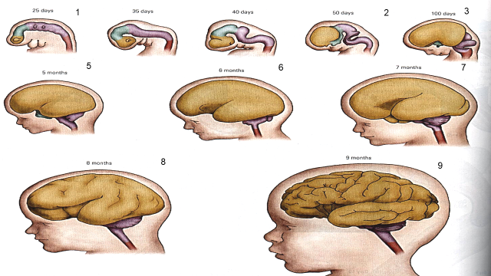
Development of the Nervous System
Dr. Arun R. Nair
Dept. of P.M, SKHMC

Slide 2
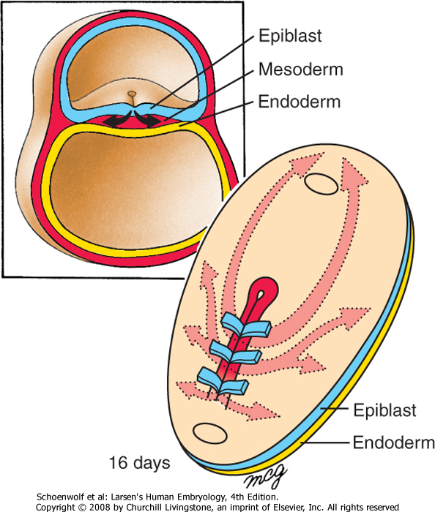
The three germ layers are formed at gastrulation
Ectoderm: outside, surrounds other layers later in development, generates skin and nervous tissue.
Mesoderm: middle layer, generates most of the muscle, blood and connective tissues of the body and placenta.
Endoderm: eventually most interior of embryo, generates the epithelial lining and associated glands of the gut, lung, and urogenital tracts.

Slide 3
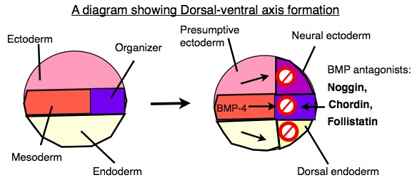
Initially BMP signaling promotes the formation of non- neural ectoderm & inhibition of BMP-4 signaling is required to establish Neuroectoderm. There after BMP gradients are essential for patterning the dorsal ventral Axis
However, the node secretes BMP-4 antagonists: (e.g. noggin, chordin, & follistatin) that allow a region of the ectoderm to develop into nerve tissue.
{Bone Morphogenetic Protein 4 are key players regulating neuronal & glial cell development from neural precursor cells in the embryonic, post natal & injured CNS}

Slide 4
Blastocyst
Gastrulation forms three primary germ layers
Trophoblast
Inner Cell Mass
Hypoblast
Epiblast
Amniotic Ectoderm
Embryonic Epiblast
Extraembryonic Endoderm
Cytotrophoblast
Primitive Streak
Yolk Sac
Extraembryonic mesoderm
Mesoderm
Endoderm
Ectoderm
Syncytiotrophoblast
Muscle, circulatory system, bones and cartilage, outer covering of internal organs, excretory system, and gonads
Inner lining of digestive system, inner lining of respiratory system, glands (including liver and pancreas)
Epidermis and associated structures (skin, nails, hair)
Nervous system (CNS and PNS)

Slide 5
Development of Nervous System

Slide 6
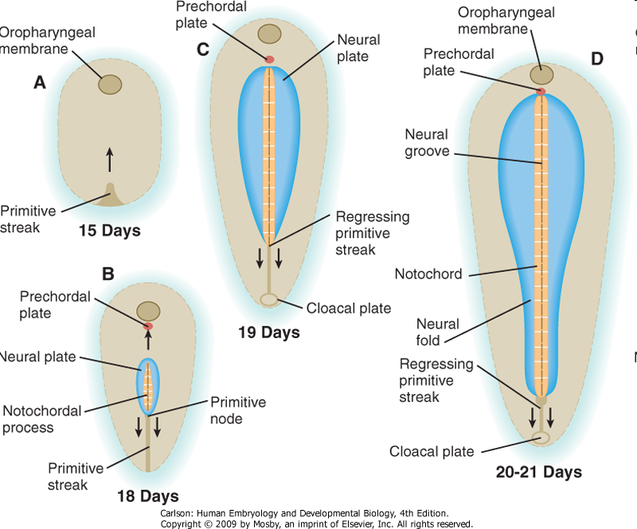
There are four stages of neural plate and neural tube formation: formation, bending, convergence, and closure. The formation of the neural plate starts when dorsal mesoderm signals ectodermal cells above it to lengthen into columnar neural plate cells.This different shape distinguishes the cells of the presumptive neural plate from other pre-epidermal cells. If the neural plate is separated by itself, it will still develop to make a thinner plate but will not form a neural tube. If the region containing presumptive epidermis and neural plate tissue is isolated, small neural folds will form.
Elongation that occurs throughout the formation of the neural plate and closure of the neural tube is vital; the closing areas of the neural tube are seen to have very increased elongation activity in the midline compared to already closed areas when the plate was beginning to shape itself into a tube

Slide 7
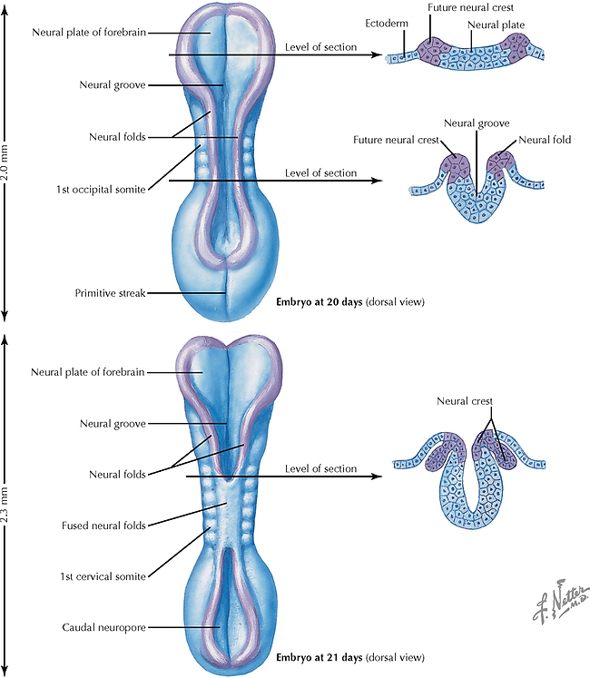
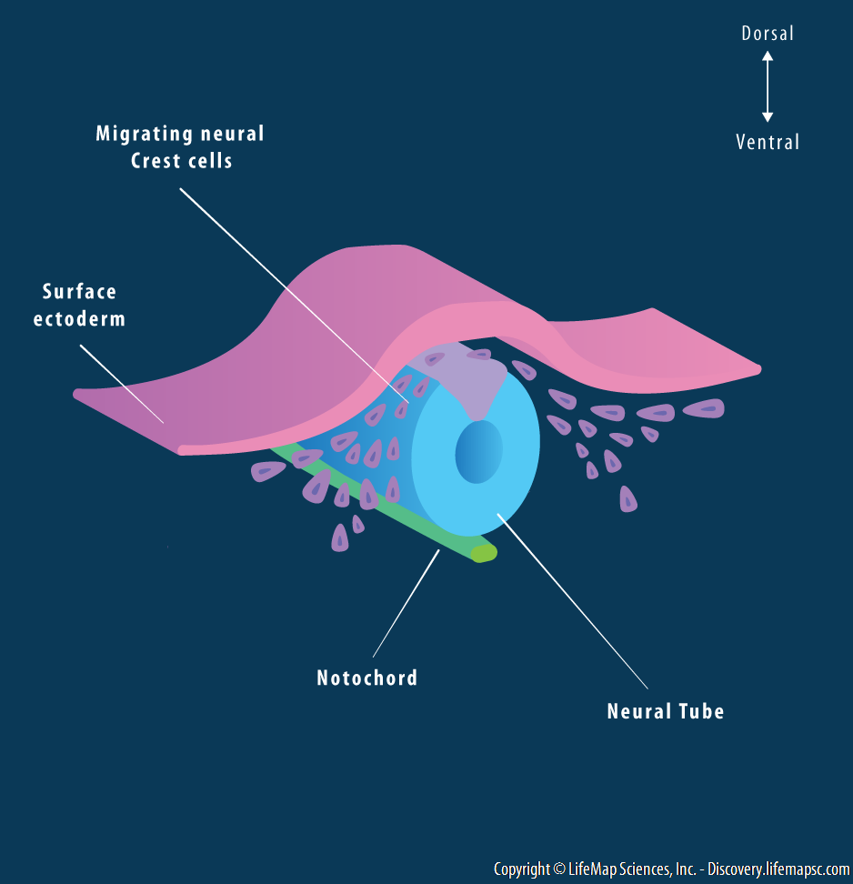

Slide 8
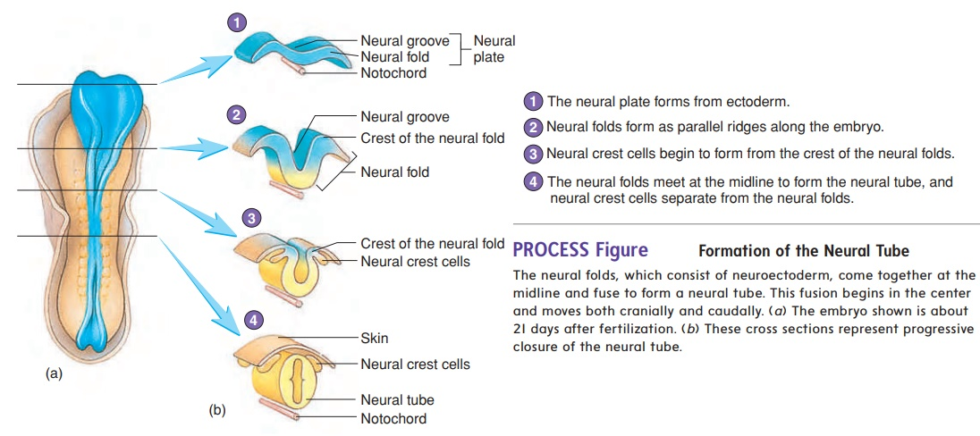

Slide 9
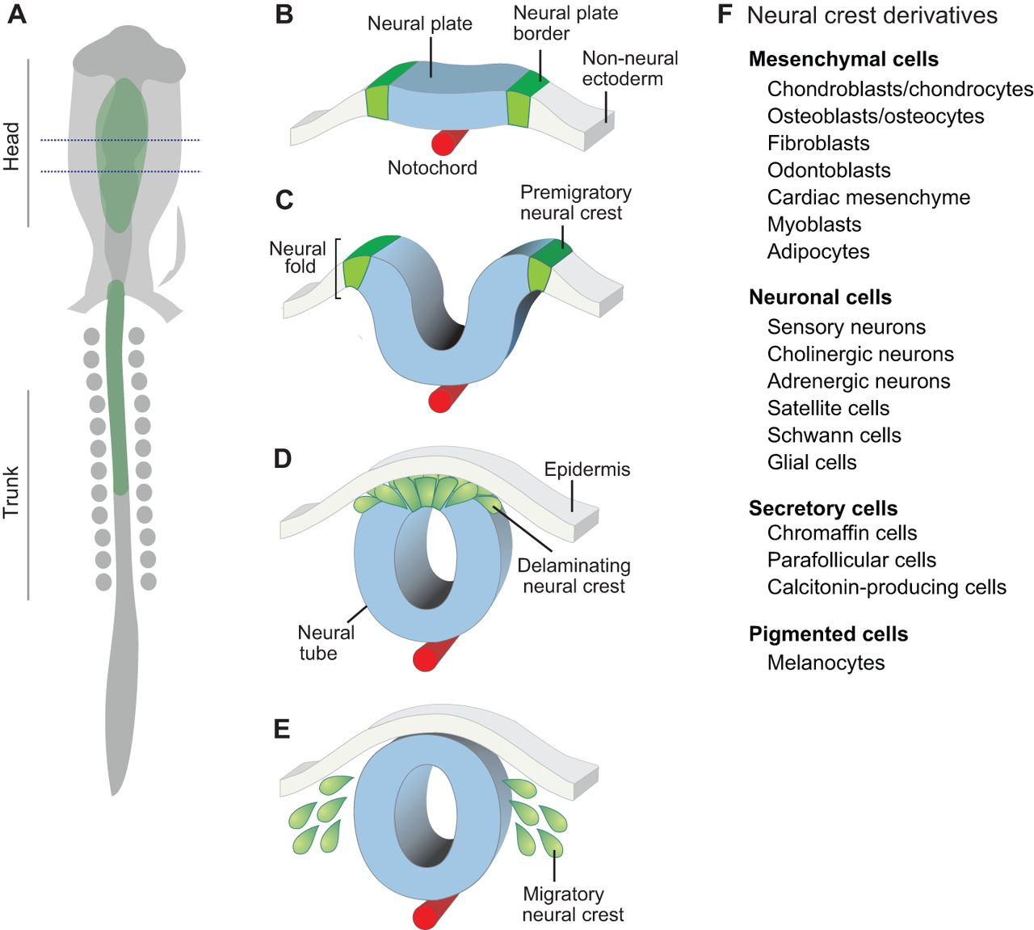
Deformity of NC:
Hirschsprung’s Disease, Aorticopulmonary Septal Defects,
Cleft Lip,
Cleft Palate,
Albinism,
Fronto Nasal Dysplasia, Neurofibromatosis.
Deformity of NT:
Posterior Rachischisis,
micro-macro-Anencephaly,
Spina bifida,
cranium bifidum.

Slide 10
Development of Brain

Slide 11
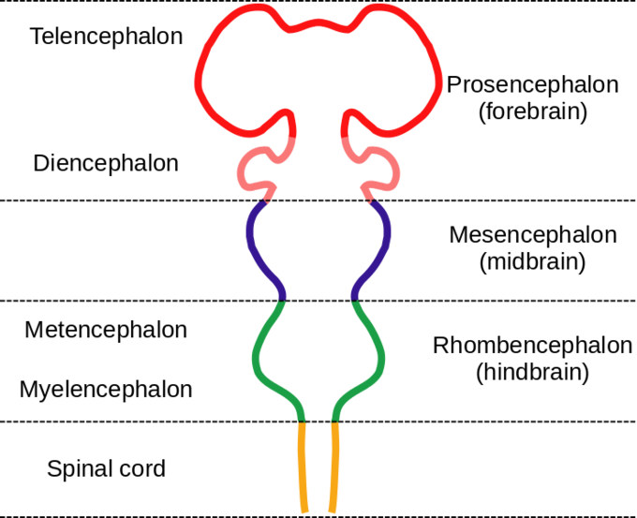
The human has the most complex brain of the primates group. Their development is prolonged beyond birth and it is not completed structurally nor neuro-chemically until age of 20 years. Decades later, degenerative phenomena begin to be evident, that little by little will drive us to death. At the end of the life, 113 grams approximate of cerebral mass are lost. The endowment of furrows and convolutions are fixed before birth, while the cerebral surface ends up having values next to the adult at 2 years.

Slide 12
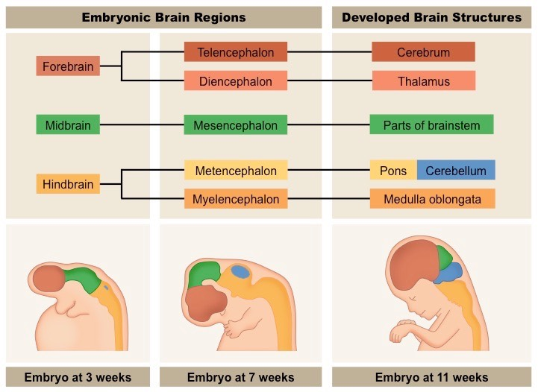

Slide 13
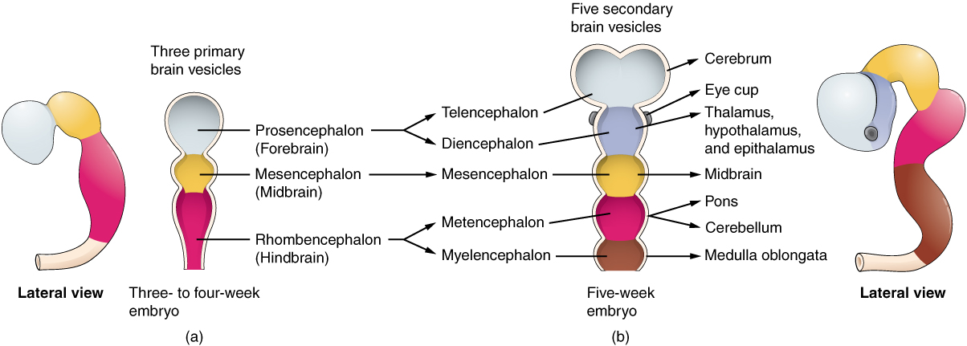

Slide 14
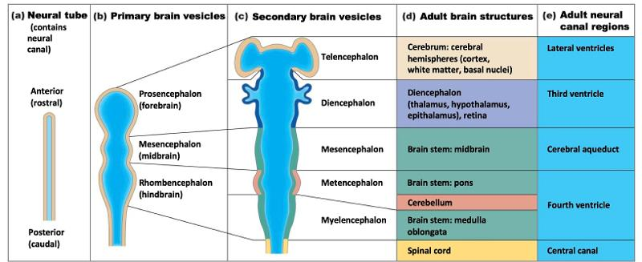

Slide 15
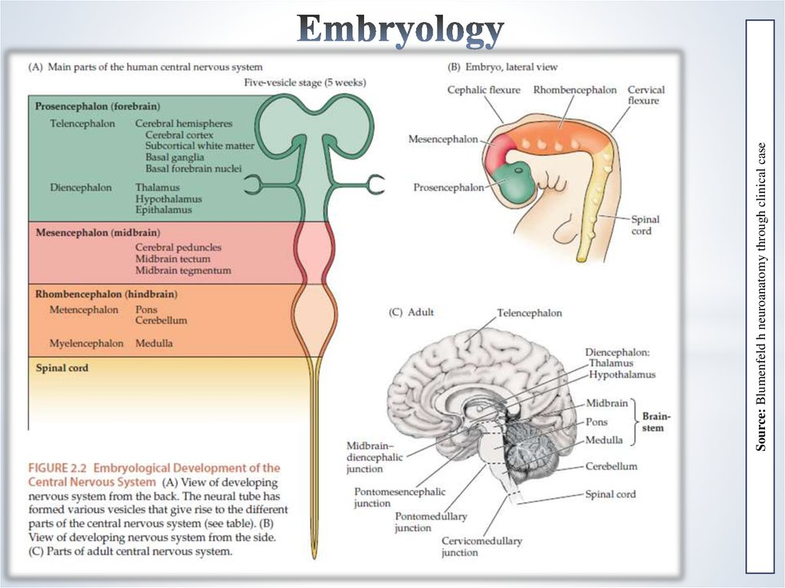

Slide 16
Prosencephalon (forebrain)→ Telencephalon & Diencephalon.
Telencephalon→ cerebral cortex, corpus Striatum & L. ventricles.
Diencephalon→ Thalamus, Hypothalamus, Epithalamus, Metathalamus, Subthalamus & Third Ventricle.
Mesencephalon (Mid Brain) →
Midbrain& cerebral Aqueduct
Rhombencephalon (hindbrain)→ Metencephalon & Myelencephalon
Metencephalon→ Pons & Cerebellum 4th Vent.
Myelencephalon→ medulla Oblangata to 4th Vent.

Slide 17
As the neural tube matures, the lateral walls thicken and form a longitudinal groove called the sulcus limitans, which extends the length of the spinal cord and divides the spinal cord into dorsal and ventral portions. The dorsal portions are called the alar columns (or plates), the location of the sensory somatic and visceral input, and the ventral portions are called the basal columns (or plates), location of the motor function output.
While dorsal patterning is induced by signals coming from the surrounding epidermis, ventral patterning is induced by signals from the adjacent notochord. Neuroblasts in the dorsal half of the spinal cord form commissural and association neurons, while ventrally located neuroblasts form somatic and visceral motor neurons and ventral interneurons.

Slide 18
Circuits involved in proprioception and motor control are largely confined to the ventral spinal cord. Dorsal root ganglion neurons differentiate from neural crest progenitors. As the dorsal and ventral column cells proliferate, the lumen of the neural tube narrows to form the small central canal of the spinal cord. The grey matter bulges, forming white funiculi, and septi.
Following the closure of the caudal neuropore and formation of the brain ventricles that contain the choroid plexus tissue, the central canal of the caudal spinal cord fills with cerebrospinal fluid (CSF).

Slide 20
Stages of Development of the Nervous System
Initial Embryonic Development: Fertilization, cell divisions, implantation, and gastrulation .
2. Neurulation: Establishment of primordial nervous system in early embryo.
3. Proliferation: Initial generation of neuronal/glial precursors from undifferentiated precursor cells.
Migration/Aggregation: Movement of neurons and glia from the sites of generation to their final positions.
5. Differentiation: Determination of the type of neuron or glial cell.
6. Targeting/Synaptogenesis: Formation of axon pathways and synaptic connections .
7. Programmed Cell Death/Synapse Refinement: Some neuronal death, elimination of some synaptic connections, changes in synaptic strength .
0- 2 wks
2 wks - 5 wks
5 wks - 6 mos PN
5 wks - 25 wks
25 wks - 6 mos PN
25 wks - adult
25 wks - adult

